Slide 1
DABT Study Group
2013 Recert Exam
Questions 9-16

Slide 2
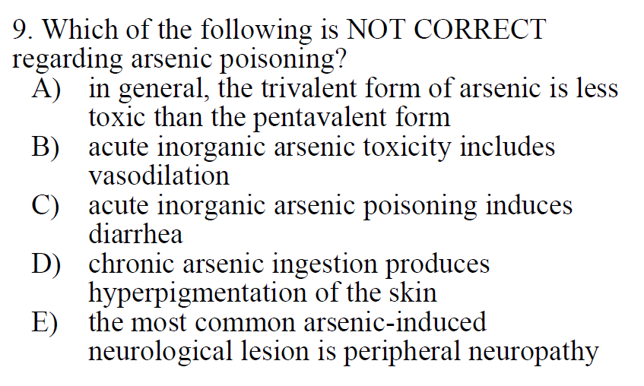

Slide 3
A) False – Page 937 7th Ed.
Trivalent As (As³⁺) is more toxic than Pentavalent (As⁵⁺) form

Slide 4
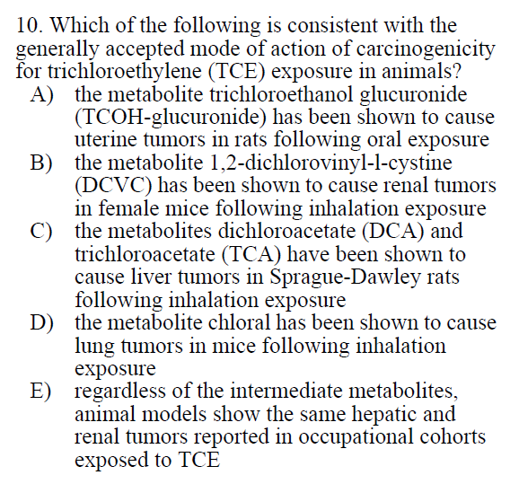

Slide 5
A) Uterine tumors not indicated
B) Male but not female rats
Chapter 24
C) TCE causes liver tumors in B6C3F1 mice but not other mouse strains or rats
Page 1050 8th Ed
D)p. 1051 8th Ed
E) Epi evidence for liver and lung in humans is low

Slide 6
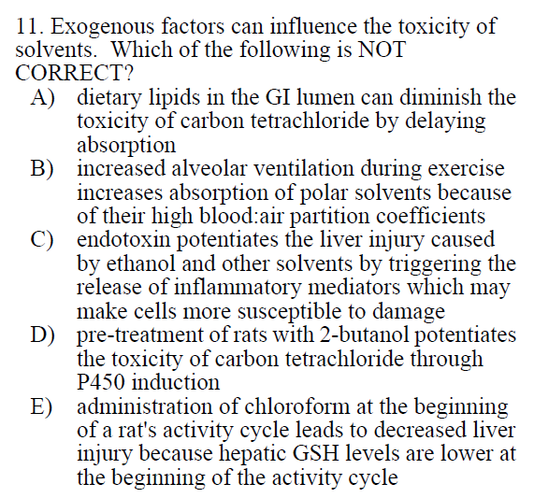

Slide 7
A-D) True – See Ch. 24 C&D
E) False: lower hepatic GSH at the beginning of a rat’s activity cycle will lead to increased liver injury
Page 996 C&D 7th Ed. (1061-63 8th Ed)

Slide 8
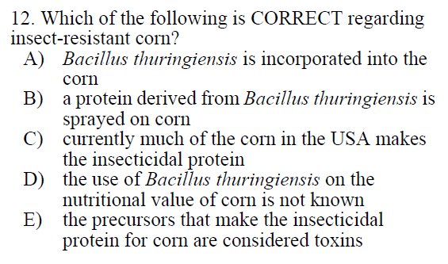

Slide 9
A) Only a protein derived from Bacillus thuringiensis is incorporated into the plant (Bt protein).
B) The protein is not sprayed on the corn
C) True (~80% of market)
D) It does not affect the nutritional value
E) False – the crystal Bt proteins are solubilized in the insect gut, which is alkaline, and proteolyzed to a toxic form (δ-endotoxin)
Ch. 22, p 957-8 C&D 8th
https://en.wikipedia.org/wiki/Bacillus_thuringiensis
https://www.ers.usda.gov/data-products/adoption-of-genetically-engineered-crops-in-the-us/recent-trends-in-ge-adoption.aspx

Slide 10
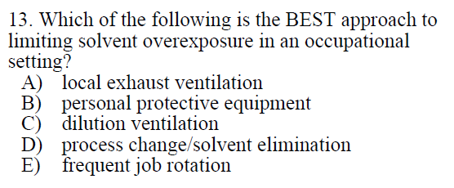

Slide 11
A-C) good approaches, but not the best
D) Correct – Solvent elimination would be included in engineering controls
page 1290 C&D 7th Ed./page 1408 C&D 8th Ed.
D) not indicated – potentially related to “work practice controls”

Slide 12
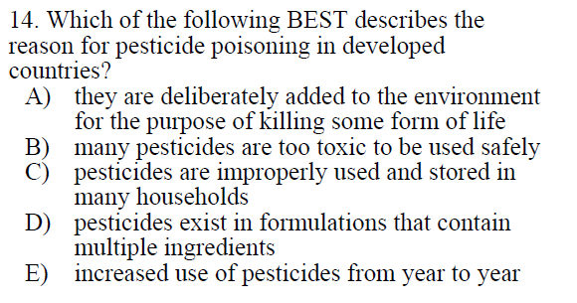

Slide 13
C) page 886 C&D 7th Ed./page 935-6 C&D 8th Ed.
E) Pesticide use has plateaued over last 20 years

Slide 14
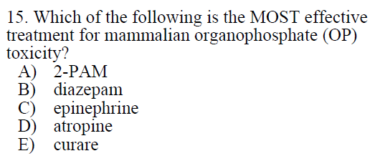

Slide 15
A) Not best answer – Facilitates dephosphorylation prior to aging. Used alone in mild cases
B) Not best answer – used to treat anxiety and muscular effects of OP poisoning
C) Not indicated – plays a role in flight-or-fight response, binds to adrenergic receptors
D) Correct – The “cornerstone of treatment”
a muscarinic receptor antagonist (p941 C&D 8th Ed.)
E) Not indicated – plant extract used in poison arrows, causes paralysis which can be reversed by a cholinesterase inhibitor such as pyridostigmine

Slide 16
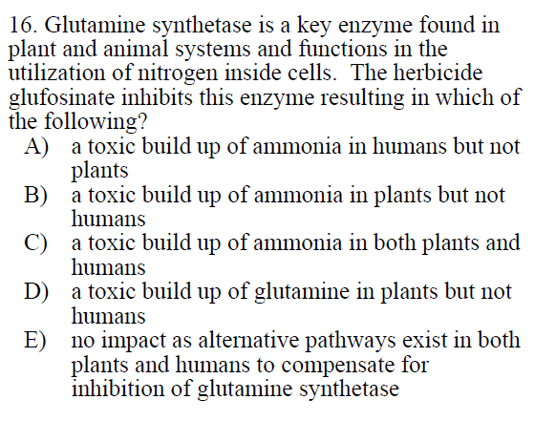

Slide 17
Glutamate + ATP + NH3 → Glutamine
B) Mammals have other metabolizing systems to deal with inhibition of glutamine synthetase (p. 965 C&D 8th ed.)

